Slide 1
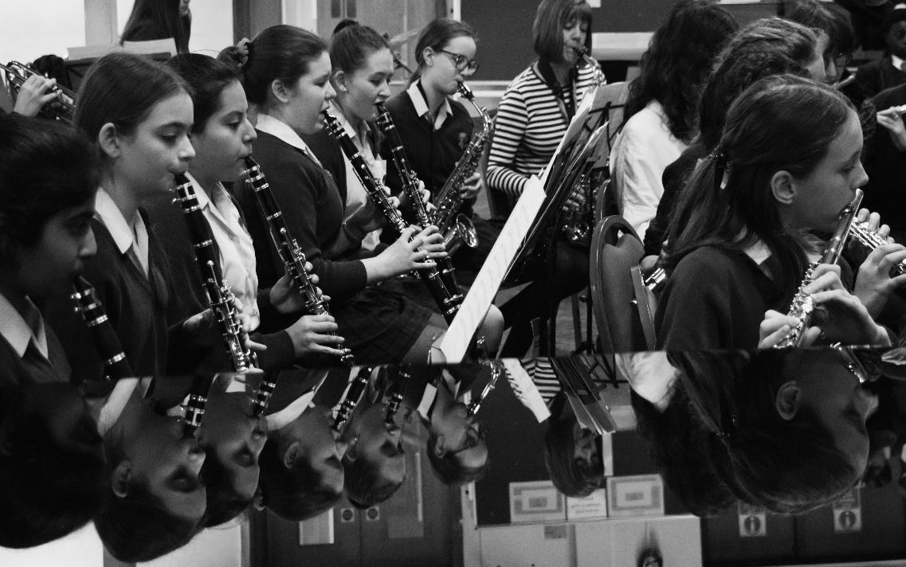
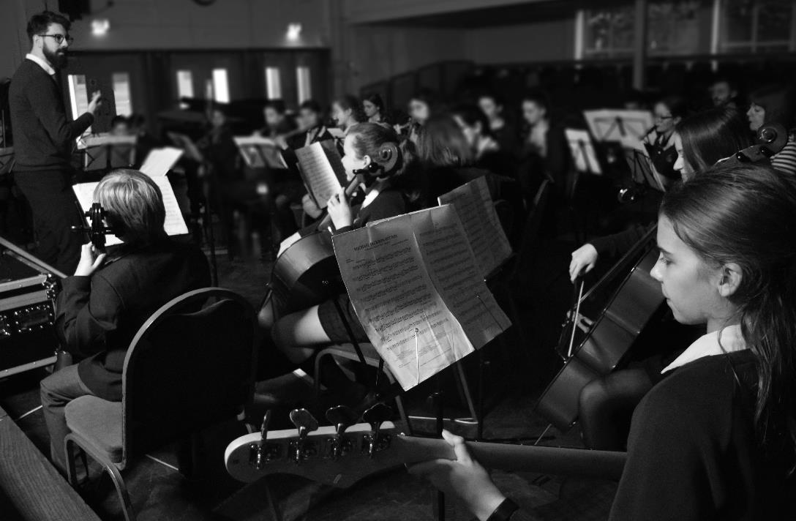
Music @ BWSFG
TWITTER | INSTAGRAM | YOUTUBE
@bullermusic | @bullerswoodmusic | Mr Parsons

Slide 2
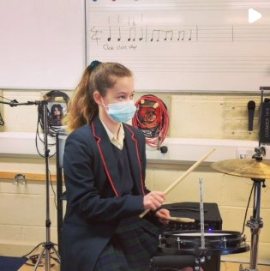
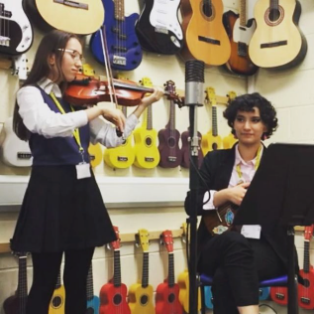
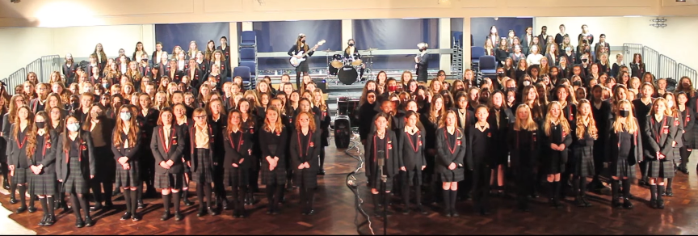
Extra Curriculum
Outside of classroom music lessons there are two further opportunities for engaging with music at Bullers Wood.
After school ensembles
Peripatetic instrumental/vocal lessons

Slide 3
Extra-curricular music

Slide 4
Peripatetic instrument/vocal lessons
Anyone can have one to one instrumental/vocal lessons
These can be on any instrument or voice
Lessons can be 15/20/30 minutes
They take place during the school day
Same day every week but different times because of rotation

Slide 5
How to apply for music lessons
Fill out a form (at front)
Select the instrument and length of lesson
If you do not have an instrument, you can hire them from BYMT
Return the completed form to MR A PARSONS (Head of Music)
Check emails for contact from teacher

Slide 6
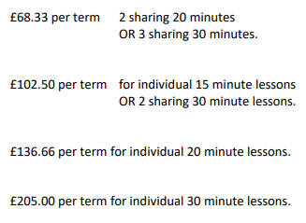
Fees
30 lessons a year (10 a term)
The teacher will invoice you directly
Prices for 2022/23 below:
If your child is in receipt of pupil premium, they are eligible for 20-minute lessons from this money

Slide 7
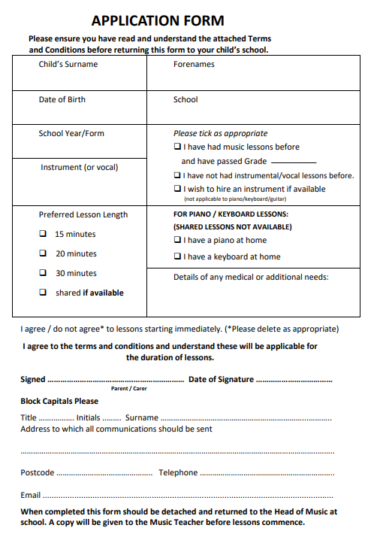
The form

Slide 8
Band on the run
The year the music department in running band on the run
Students to learn either trumpet/trombone on a 5-week course
3 sessions a week of half an hour
First come first served, up to 15 places
Cost: £90 - includes instrument hire
There will be sign up form sent out via email

Slide 9
Welcome
6pm | Refreshments | Main Hall
6:30pm | Form Tutor Presentations: Angelou Blackman Grey-Thompson Lovelace Parks Seacole Shilling Watson | SA8 SA2 SA4 SA3 SA5 SA10 SA6 SA9
7pm | Presentations: Transition Parental Partnership Safeguarding and Growth Mindset Friends of Bullers Wood | Main Hall
Schedule

Slide 10
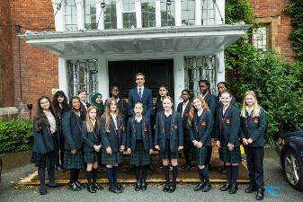
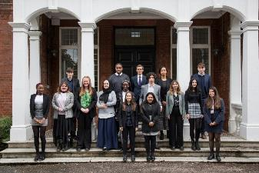
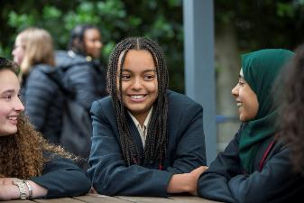
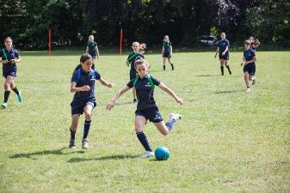
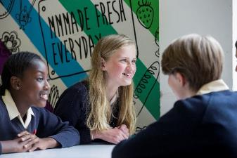
Simon Hardwick
Headteacher

Slide 11
Transition from Primary to Secondary

Slide 12
Teacher Per subject
New subjects
Greater organisational skills
New rules
More homework
Meeting deadlines
Independent travel to school
Size of school
1534 pupils
Being the youngest
Finding way to lessons
New friendship groups
New routines

Slide 13
RESILIENCE
Optimism – To be able to choose to look on the brighter side of life.
Emotional awareness and control – the ability to understand how you feel and how to control the feelings that you express so that they remain appropriate for a given situation.
Impulse control and self-regulation – the ability to sit back and look at things in a thoughtful way before acting.
Empathy and connection – the ability to notice and correctly interpret the needs and wants of other people.
Self-efficacy – confidence and belief in your ability to solve problems and achieve goals for yourself.
Flexible and accurate thinking - the ability to think about a challenge or adversity in helpful ways.

Slide 14
Sleep helps to fuel your brain and your body. Teens need more sleep because their bodies and minds are growing quickly. Scientific research shows that many teens do not get enough sleep. To be at your best, you need between 8 and 10 hours of sleep every day.
Notes:
.

Slide 16
A Growth Mindset for learning

Slide 17
What is mindset?
A mental attitude that determines how you will interpret and respond to situations.

Slide 18
What we KNOW ABOUT SUCCESS
The distinguishing feature of geniuses is their passion and dedication to their craft, and particularly the way in which they identify, confront, and take pains to remedy their weaknesses (Good, Rattan, & Dweck, 2008).

Slide 19
A Growth Mindset
Home Environment

Slide 20
Praise
Praise the process NOT the result

Slide 21
Failure

Slide 23
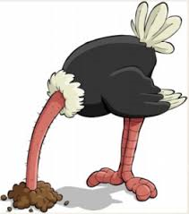
Failure avoidance techniques
Absent on the day of assessments
Copy and paste work from websites/peers
Dedicate no effort to homework
Late to lessons

Slide 24
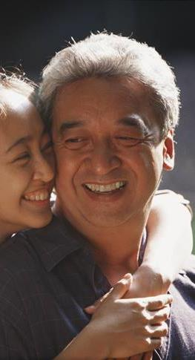
“If parents want to give their children a gift, the best thing they can do is to teach their children to love challenges, be intrigued by mistakes, enjoy effort, and keep on learning.” – Carol Dweck

Slide 25
​
Keeping Safe in our Community
​
Students can speak to these members of staff if they have a concern about their safety or the safety of others. We are trained to deal with disclosure and sensitive information. Parents can ask to speak to the school's Safeguarding Leads if they have a concern to report.
Mrs Michelle German
Designated Safeguarding Lead (DSL)
Mrs Marie Hemmings
Deputy Designated Safeguarding Lead

Slide 26
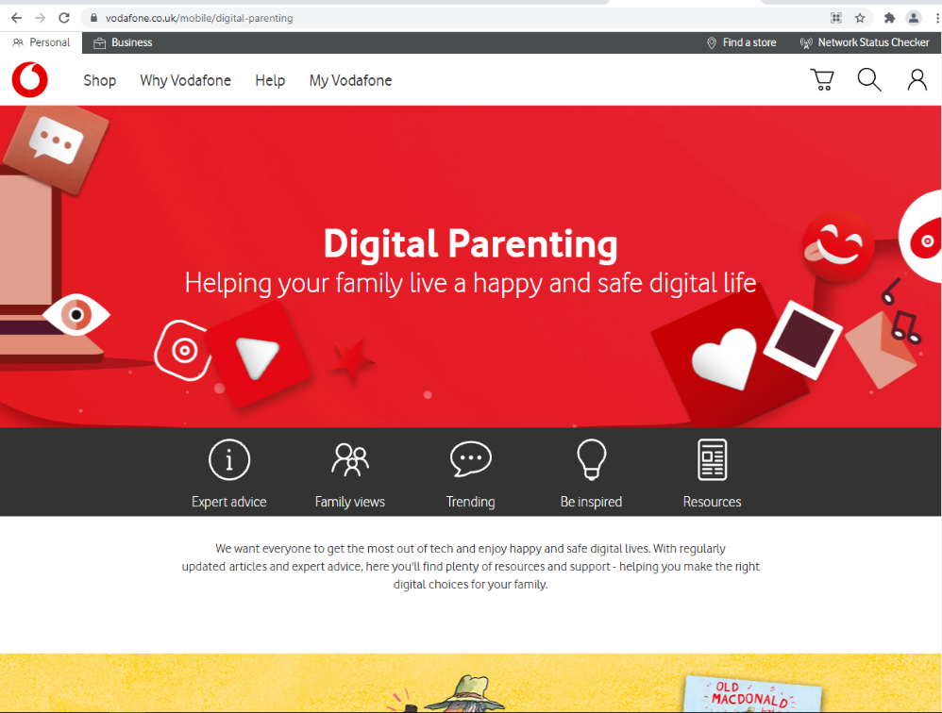
Social media- these apps are age 13+
https://www.vodafone.co.uk/mobile/digital-parenting

Slide 27
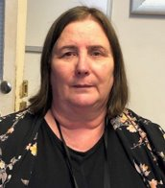
Our SENCO
Ms Belinda Shaw
SEND – school create a partnership
Clear and transparent system for referral​
In class: quality first teaching
Interventions​
Access arrangements​

Slide 28
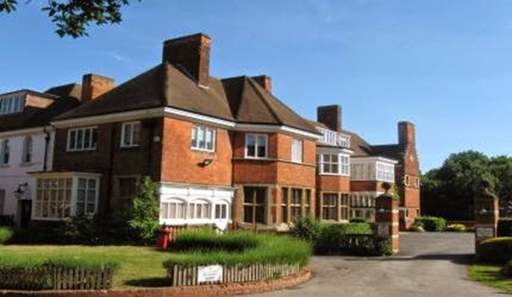
Reception

Slide 29
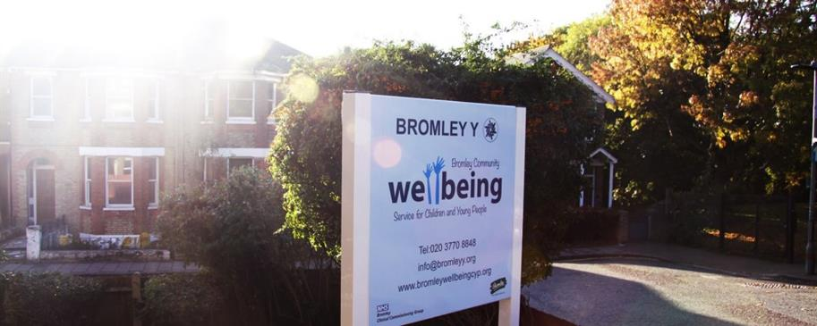
Wellbeing

Slide 30
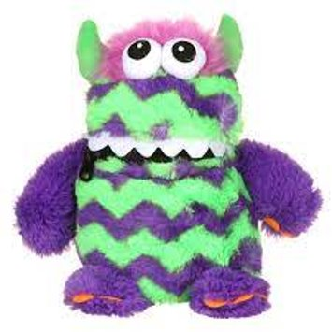
Form Time Care Creatures

Slide 31
Personal Development

Slide 32
Personal development

Slide 33
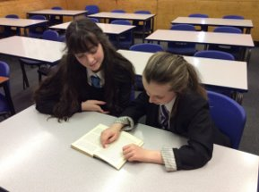
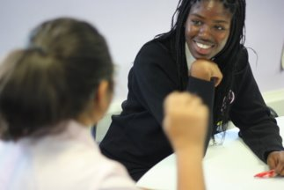
Pastoral and academic support

Slide 34
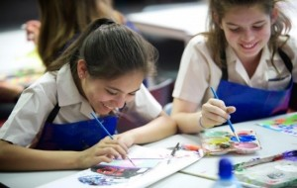
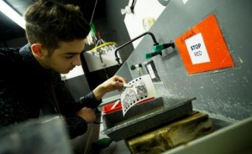
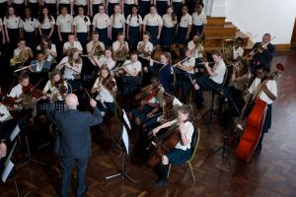
FRIENDS OF BULLERS WOOD

